Slide 1
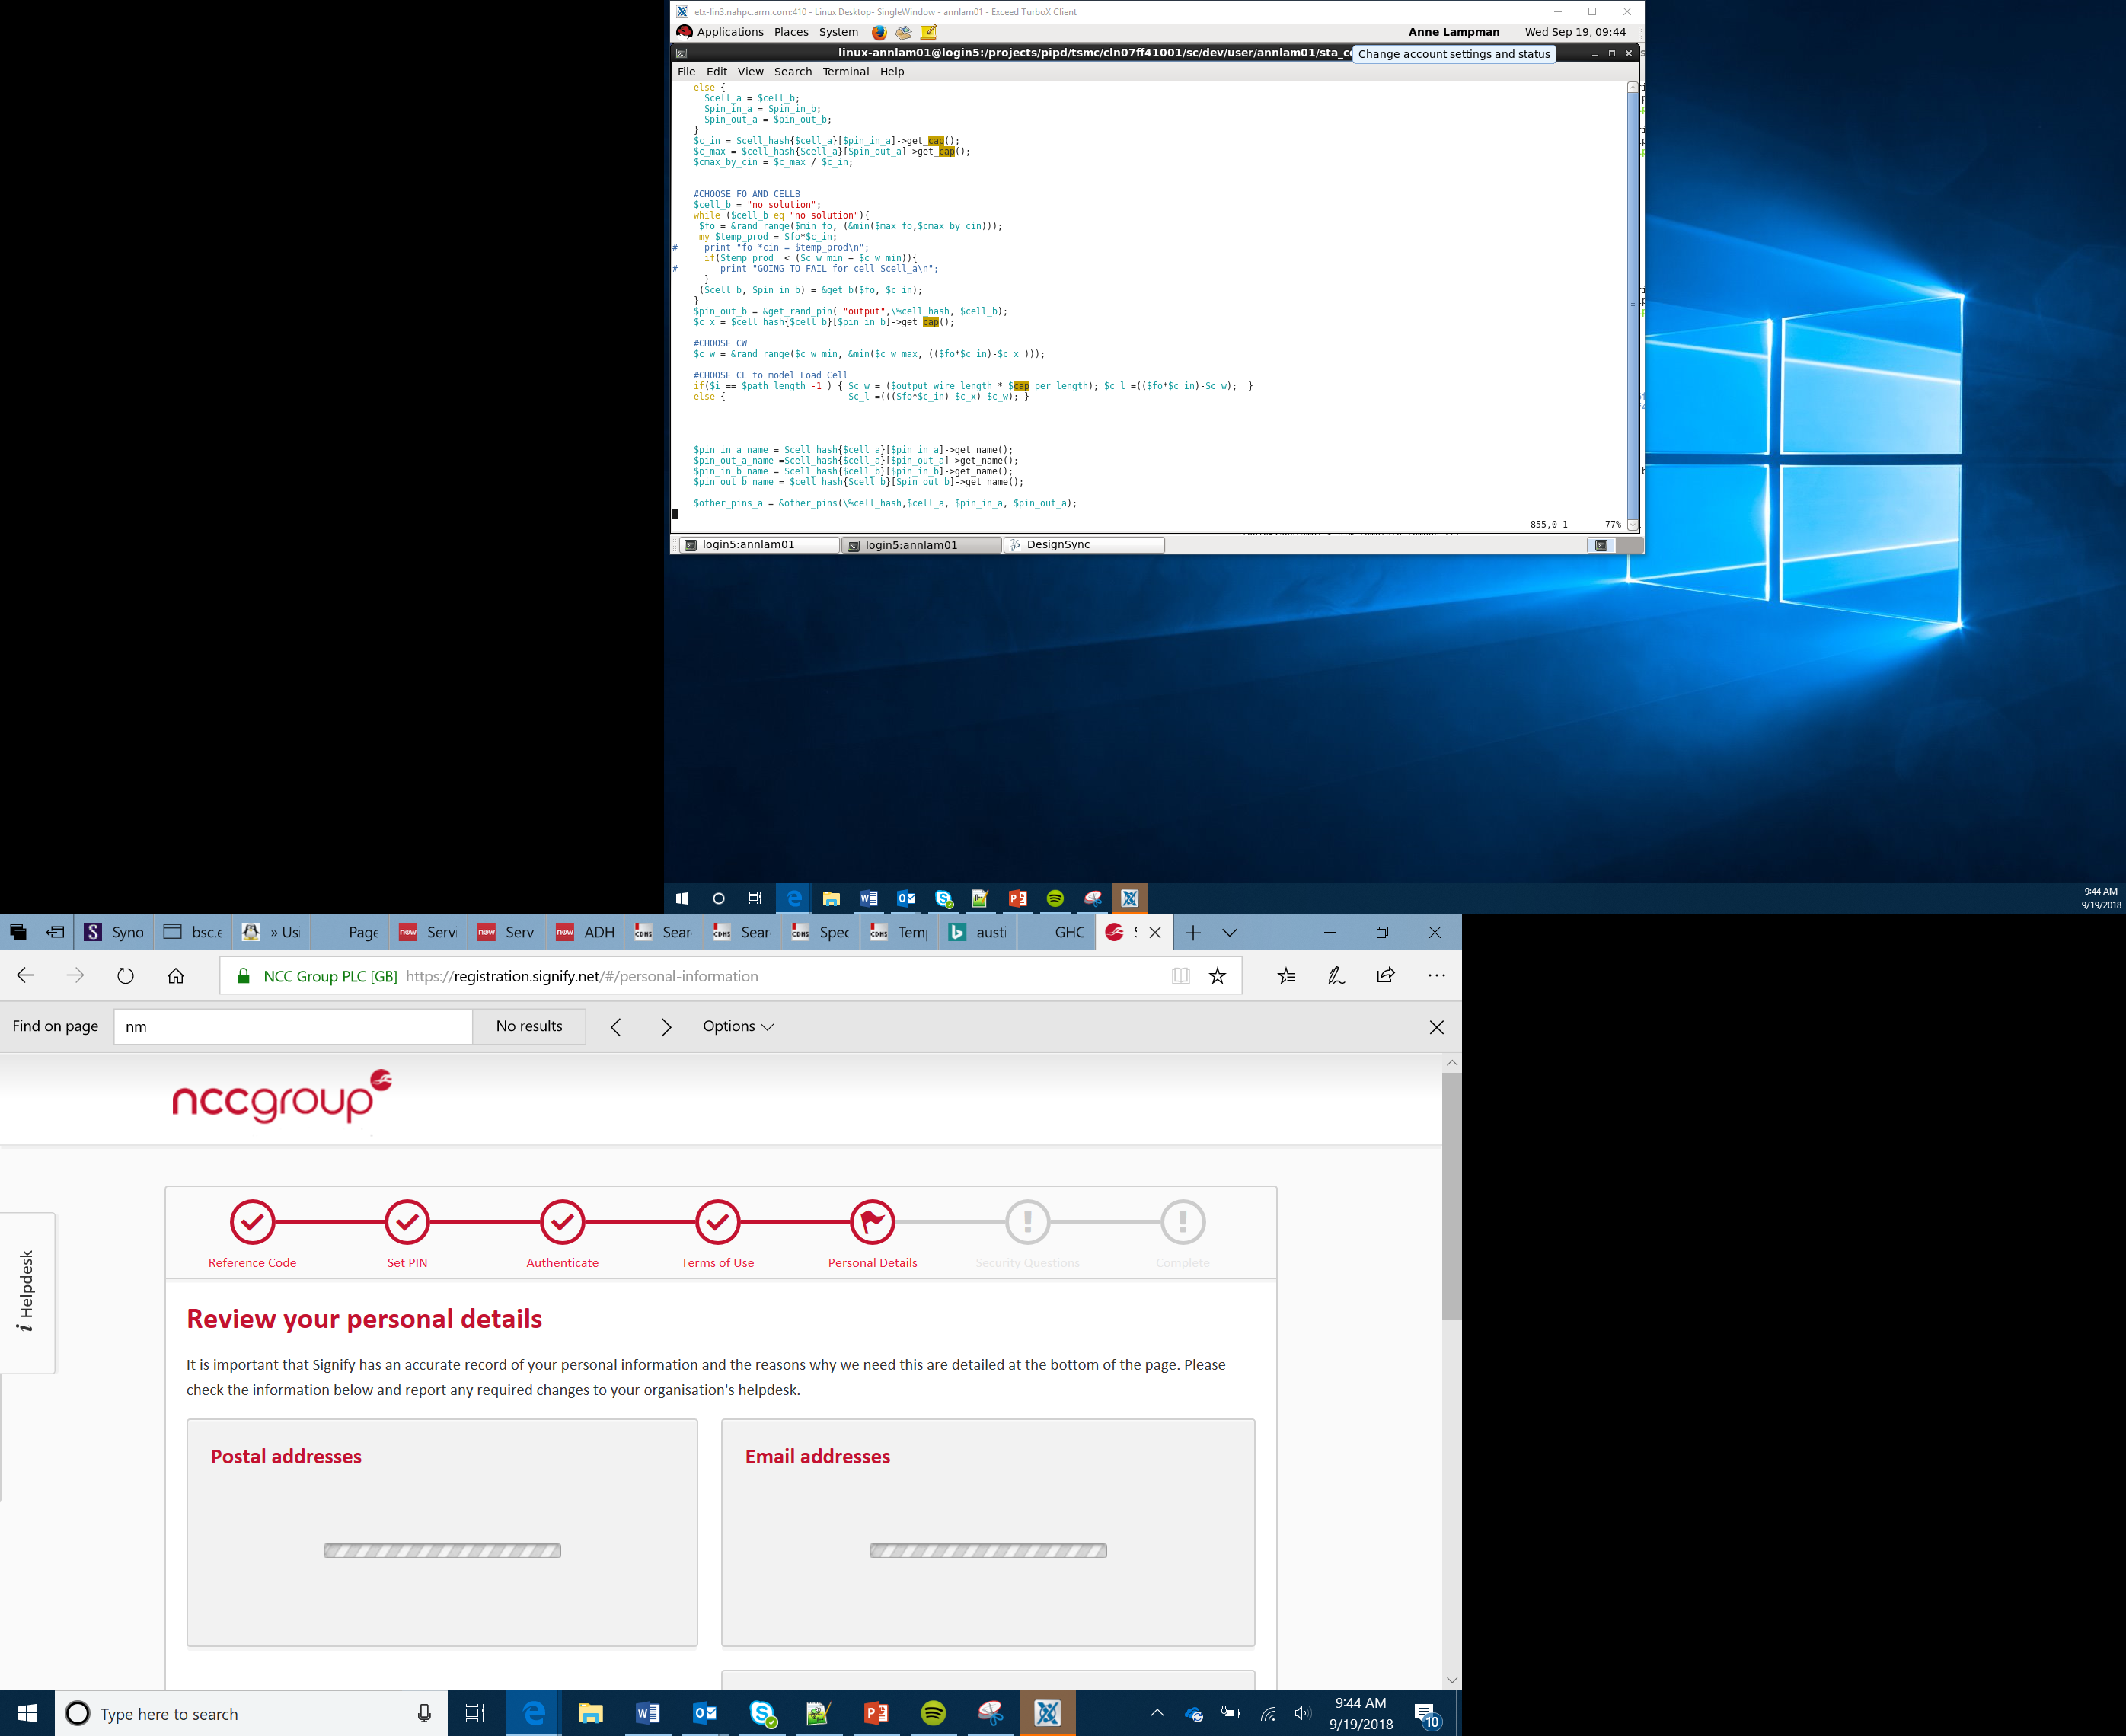

Artificial Intelligence and Machine Learning
Lesson 22-23

Slide 2
Objectives
Understand what artificial intelligence (AI) and machine learning (ML) are
Consider ways that AI and ML can be applied
Devise an algorithm for an AI Healthcare robot
Notes:
Introduce the objectives

Slide 3
Artificial Intelligence and Machine Learning
Artificial Intelligence and machine learning are terms that are often used interchangeably but are not quite the same thing.
Artificial Intelligence (AI) is the concept of machines being able to carry out tasks in a way we would consider smart eg complex calculations or an interactive manikin in a museum
Machine Learning (ML) is an application of AI where the machine learns for itself and adapts to changing situations by processing large sets of data – eg your home smart speaker learning to recognise the different voices of people in the family or a cancer detection systems that improves its detection rates as it experiences more X-rays
Notes:
Explain what AI and ML are
Ask Learners if they have come across any example (good examples are smart speakers like Alexa and Siri as well as electronic chess games)

Slide 4
Artificial Intelligence and Machine Learning
Current AI and ML Uses
Data Security
Malware and viruses are a huge problem. Recent issues with the UK NHS system showed how big the problem is. Machine learning looks for patterns in online data access and report anomalies that may predict a security breach
Personal Security
Machine learning can speed up security lines for major events or air travel by reducing false alarms or picking up on things that human screeners might miss
Healthcare
Machine learning systems are being used to detect breast cancer with a very high accuracy rate and often earlier than their human doctor counterparts
Notes:
Discuss the current development of AI and ML
The UK NHS failure is a good example for how AI could have helped
The cancer detection system is a good example of how ML is being used to increase the accuracy and speed of cancer detection

Slide 5
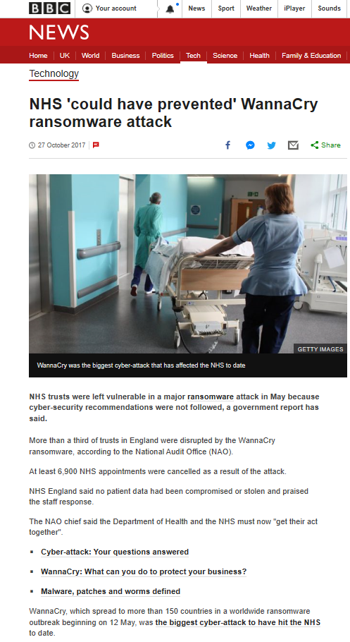
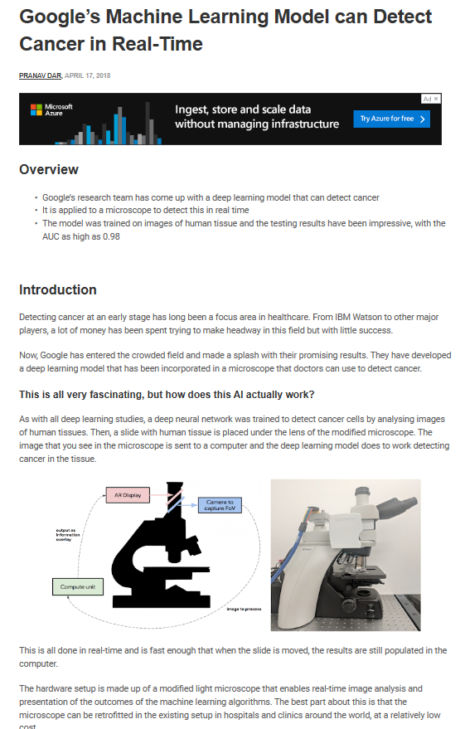

Slide 6
Artificial Intelligence and Machine Learning
Current AI and ML Uses
Natural Language Processing
Call routing more effectively on customer service lines
Translating obscure languages, perhaps using a smart speaker like Amazon Echo as a translator when no one is available.
Smart Cars
Self-driving vehicles, collision avoidance systems, smart roads
Vehicles could learn a driver’s habits and adjust the internal environment to suit
The car adjusts itself to meet new and changing road and weather conditions
Notes:
Discuss the current development of AI and ML

Slide 7
Video
Current AI and ML Uses
Use the video links below or embedded in the following slide to look at how AI and ML are being utilised in the world today:
https://www.youtube.com/watch?v=9Mz84cwVmS0
https://www.youtube.com/watch?v=x1Qu1YKZA0Y
https://www.youtube.com/watch?v=bE4DnQ5GlTc
Notes:
The videos here are links to YouTube and are also embeded on the next three slides
They discuss
AI in cancer detection
AI Home Healthcare
AI Robot Teacher If not available any similar topic videos would be useful

Slide 8
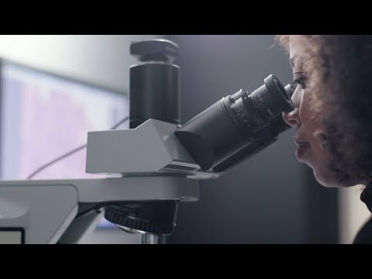
AI Cancer Detection

Slide 9
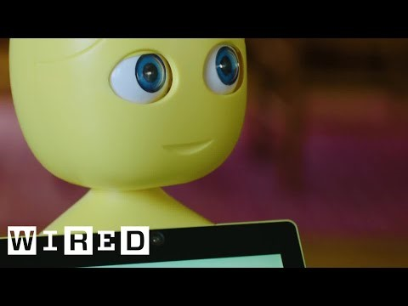
AI Home Healthcare

Slide 10

AI Robot Teacher

Slide 11
AI / ML Design Challenges
Plan AI/ML system that could be used for the following situations:
Pooper Scooper
Detecting and clearing animal waste from parks and gardens
Robotic cleaners
Identifying and cleaning up mess in houses and flats
Robotic Child Car or Teacher
Robotic system to ‘baby sit’ young children or use to replace or support teachers in classroom
Healthcare Robot
Robotic systems to give elderly, infirm and chronically ill patients more independence
Notes:
Discuss the design challenges above.
Give the Learners the lesson worksheet
Get Learners to discuss these in groups. They should think about:
What the device would actually do
How it would work
What sensors they might use
If there are any moral or ethical concerns in replacing humans with robots in this area

Slide 12
Healthcare Robot
You have been asked to design and prototype the technology that could be used as an embedded system in a healthcare robot
The system must be able to perform the following tasks plus any others you can add:
Identify fever or low temperatures (normal 36.5°C–37.5 °C)
Warn the patient both audibly and visibly of any problems
The micro:bit has a simple temperature sensor built in that can be accessed by block.
Notes:
Optional - Pulse Sensor Module (XD-58C) eg £1.75 from Amazon (simple sensor where you can read an analogue value in)
BMP180 Barometric Pressure and Temperature Sensor eg £5.99 from Amazon (Can read temperature using the BMP180 extension)
Discuss the AI task
Use the planning space on the Activity Sheet
Try to get the Learners to attempt to create a working system either with the built in temperature sensor or by utilising additional sensors as mentioned on slides

